Slide 1
Chapter 25.
Domain Name System
25.1 Name Space
25.2 Domain Name Space
25.3 Distribution of Name Space
25.4 DNS in the Internet
25.5 Resolution
25.6 DNS Message
25.7 Types of Records
25.8 Registrars
25.9 DDNS
25.10 Encapsulation
Computer Networks
25-<number>

Slide 2

Example of using the DNS service
Computer Networks
25-<number>

Slide 3

Domain name space
Flat name space, Hierarchical name space
Computer Networks
25-<number>

Slide 4
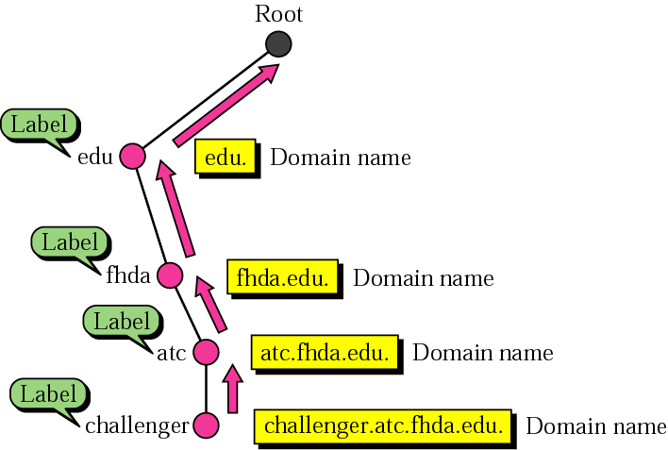
Domain names and labels
Computer Networks
25-<number>

Slide 5
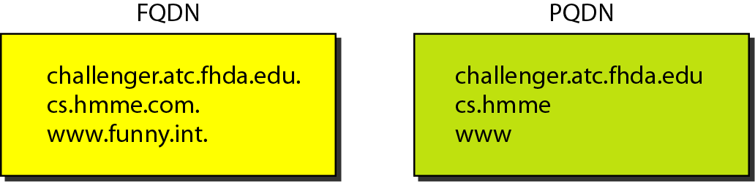
FQDN and PQDN
FQDN (Fully Qualified Domain Name)
PQDN (Partially Qualified Domain Name)
Computer Networks
25-<number>

Slide 6
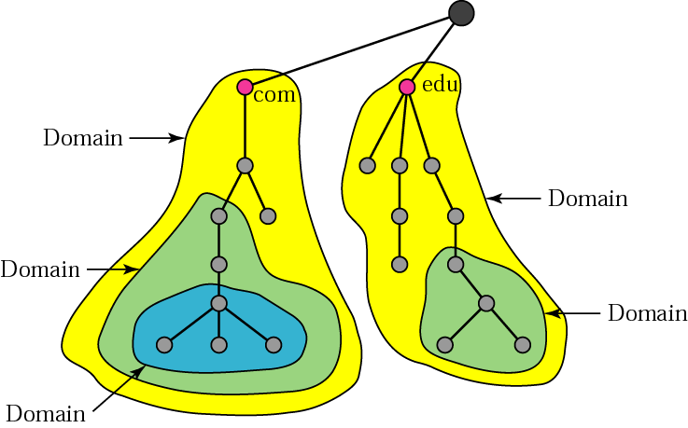
Domains
Domain: Subtree of the domain name space
Computer Networks
25-<number>

Slide 7
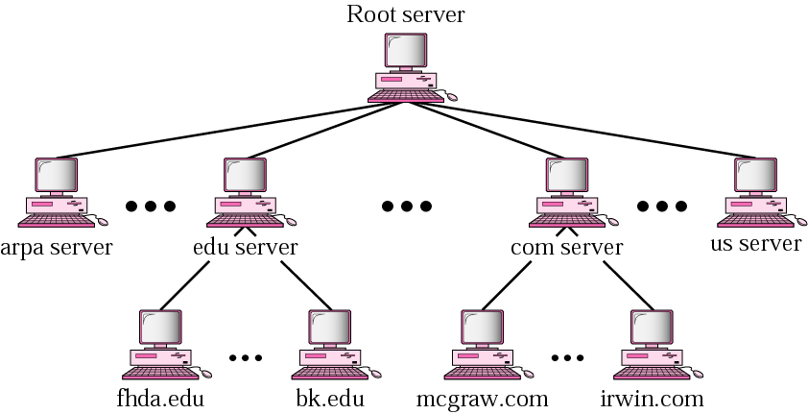
Hierarchy of name servers
Computer Networks
25-<number>

Slide 8
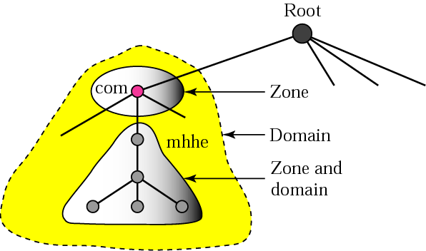
Zones and domains
Zone: What s server is responsible for, or has authority over
Computer Networks
25-<number>

Slide 9
Root Server
A root server is a server whose zone consists of the whole tree.
Primary and Secondary Servers
A primary server loads all information from the disk file; the secondary server loads all information from the primary server. When the secondary downloads information from the primary, it is called zone transfer.
Computer Networks
25-<number>

Slide 10

DNS in the Internet
Computer Networks
25-<number>

Slide 11

Generic domains
Generic domains define registered hosts according to their generic behavior
Each node in the tree defines a domain, which is an index to the domain name space database.
Computer Networks
25-<number>

Slide 12

Generic domain labels
Computer Networks
25-<number>

Slide 13

Country domains
Computer Networks
25-<number>

Slide 14
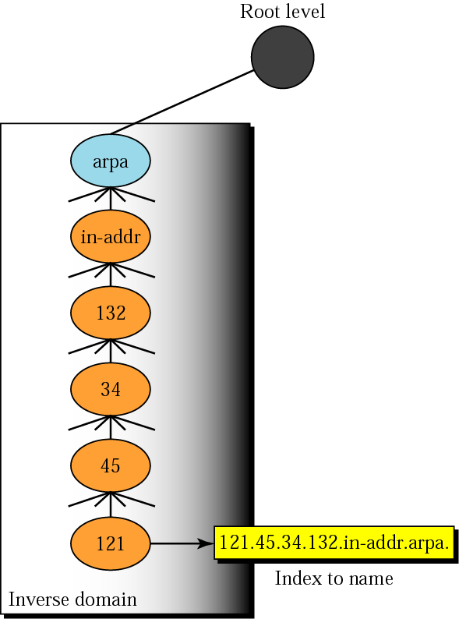
Inverse domain
Computer Networks
25-<number>

Slide 15

Resolution
Name-address resolution: a name to address/an address to a name
Resolver: DNS client called by a host
Recursive resolution and iterative resolution
Computer Networks
25-<number>

Slide 16

Iterative resolution
Caching
Computer Networks
25-<number>

Slide 17
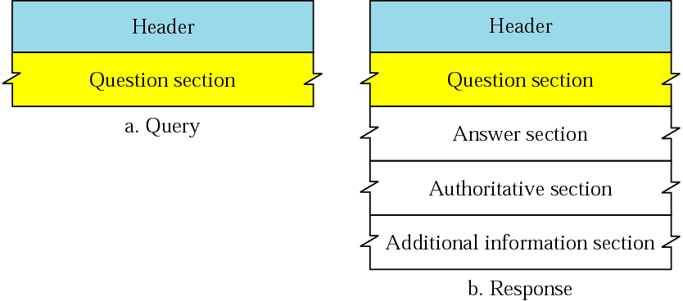
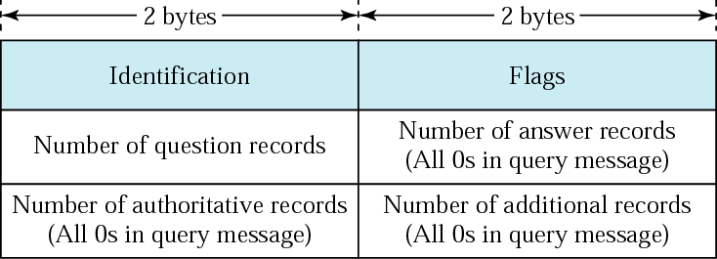
Query and response messages
DNS has two types of messages
Header format
Computer Networks
25-<number>

